Slide 1
ZooMaps by GTech
Mégane Michaud
Jordan Chen
Miles Black James Curry

Slide 2
ZooMaps:
A revolutionary social platform.
What is our application? ZooMaps is intended to be a social media platform in which users can easily find, host, and organize events that are going locally.
Who does this target? Our webapp targets a demographic consisting of students of UMass Amherst as well as faculty and residents of the surrounding area.
How can this be monetized? The project has been built to be flexible. This means that the location can easily be configured to another campus or location and attract potential investors with paid advertisements for local businesses participating.

Slide 3
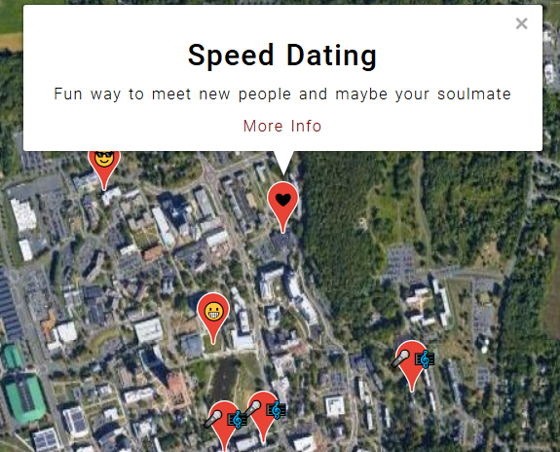
ZooMaps: Highlights of the project.
Our team prides ourselves on the integration of the Google Maps API. Users who wish to create an event can easily drag and drop a pin onto the map of our campus to indicate the location of an event. The pin can be assigned an emoji that represents the type of event going on. All of these pins are then displayed on the global events map, in which pins can be filtered out by ongoing/future/past as well as tags and search terms.

Slide 4
ZooMaps: Tasks we faced.
Easy:
Setting up user authentication.
Implementing dynamic user information onto the pages.
Writing scripts to perform development related tasks (run server, lint code, make database migrations, remove migrations files)
Hard:
Implementing the Google Maps API.
Organizing the model attributes.
Properly utilizing the forms to create an event.
Styling the pages to make them look clean and scalable.
Git issues, e.g., pushing/pulling the database sqlite file from the repository.

Slide 5
ZooMaps:
Future Features
Ability for administrators to approve and review submitted events.
A payment system so that people can set up ads and sponsored events.
Cleaned up UI to interact well on mobile devices.
A rating system between 1 to 5 stars rather than positive/negative/neutral ratings. Or a like/dislike system indicated with two buttons.
The ability to filter events by college/department.
Related to above, sign up page asks for user’s college, i.e., CICS, and only shows CICS events on startup (to avoid overwhelming user)

Slide 6
ZooMaps Live Demo

Slide 7
Conclusion
Q&A

